Slide 1
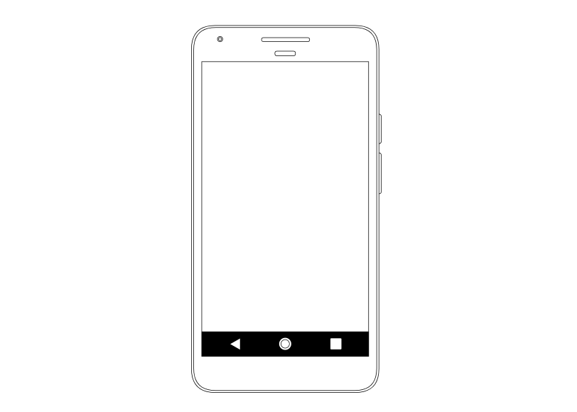
Order Confirmation
Order Summary
+ 2 -
Delete
Rs 75
+ 2 -
Delete
Rs 75
Total Order Cost: 150
Billing Info
Cash on delivery
Delivery/Pickup Location
123 Main street.
Unit 24
Zipcode 890765

Slide 2
Review Order
Quality
Quantity
Delivery
Flavor
Packaging
One word Review
Review completed

Slide 3



Add/Edit Menu
Menu Item
Chicken 65 (6 pieces)
White Rice (3 Cups)
Dish Name
Dish type
Measurement
Measurement Type
Save Item
Meal Rates & Timelines
Order Delivery Time
Place Order by
Available meal
Rate Per meal
Tags
Add Meal
Cancel Meal

